Slide 1

Hospital Management System
Theme- SDG 3 – Good Health and Well-Being & SDG 9 – Industry, Innovation and Infrastructure
Category- Software
Group No -6
Group Members-Sai Panditkar, Prathamesh Patil, Manthan Pandrekar, Tushar Parkhe
Guide-Prof. Kanchan Wankhede

Slide 2
Outline
Introduction
Literature Survey
Limitations of existing systems
Problem statement and Objectives
Proposed Methodology
Experimental Setup
Implementation
Results & Analysis
Conclusion and Future work
References

Slide 3
Introduction
Background of the Topic :-
Transitioning from traditional paper-based hospital workflows to a centralized digital ecosystem for improved data management.
Utilizing a modern web stack (React and Supa-base) to handle the complexities of real-time healthcare data.
Importance of the Problem :-
Efficient hospital operations are critical for reducing administrative stress and preventing errors in patient care.
Digital infrastructure is a core requirement for modern healthcare facilities to support "SDG 9: Industry, Innovation and Infrastructure"

Slide 4
Current Challenges :-
Manual Record Handling: Leads to significant "Stress & Delays" and physical data clutter.
Fragmented Info: Causes critical "Errors & Miscommunication" between different hospital departments.
Communication Gaps: Offline billing and lack of real-time updates hinder departmental coordination.
Motivation :-
Patient Experience: Motivated by the need for faster service and reduced waiting times for users.
Health Awareness: Improving patient health awareness by providing direct "Online access to prescriptions" and reports.
SDG 3 Alignment: Directly inspired by the goal of "Good Health and Well-Being" through better service mapping.

Slide 5
Objectives :-
Centralized Access: To develop a "Centralized HMS" for easy, role-based access across Admin, Doctor, Lab, and Patient modules.
Workflow Automation: To implement an "Automated Workflow" that increases accuracy and speed in hospital operations.
Security & Privacy: To secure sensitive medical records using "Row Level Security (RLS)" and encrypted authentication.
Digital Billing: To transition from offline methods to "Online Billing" for improved financial collaboration and transparency.

Slide 6
Literature Survey
Existing Real-World Solutions :-
Open-MRS / Bahmni: Open-source platforms used globally for managing patient records and clinic workflows.
Traditional Hospital Portals: Enterprise systems focused on large-scale administrative tasks but often lacking modern real-time synchronization.
Manual Paper Systems: Still widely used in local clinics, relying on physical files for patient history and billing.
Methodologies Used in Existing Solutions :-
Server-Side Rendering (SSR): Many older systems use heavy server-side processing which can lead to slower user interfaces.
Local Database Storage: Reliance on on-premise servers which are vulnerable to hardware failure and lack remote accessibility.
Standard Auth Modules: Use of basic username/password systems without advanced Row Level Security.

Slide 7
Per the template, the following table summarizes the analysis of literature and technical documentation.
Author/Source | Techniques/Method Used | Dataset/Platform Used | Key Results | Limitations
React Docs | Component-based UI Architecture | JavaScript / Vite | High modularity and fast frontend rendering. | Does not handle backend or data persistence.
Supabase Auth | JWT-based Authentication | PostgreSQL | Secure, scalable user session management. | Dependency on third-party cloud availability.
NCBI Research | AI in Preventive Healthcare | Medical Study Data | Improved early diagnosis using predictive models. | High risk of inaccurate outputs if inputs are wrong.
Supabase RLS | Row Level Security (RLS) | PostgreSQL Policies | Database-level protection for sensitive records. | Increases database configuration complexity.

Slide 8
Analysis of Limitations in Surveyed Solutions :-
Rigid Access Control: Many systems fail to provide fine-grained, role-based permissions, exposing sensitive data to unauthorized staff.
Lack of Real-time Sync: Existing solutions often require manual page refreshes, leading to "Errors & Miscommunication" between Lab and Doctor modules.
Inflexible Architectures: Traditional systems are often "Fast to develop" initially but become "Minimal for future features" due to monolithic designs.
High Operational Costs: Proprietary systems often require "Extra hardware" and "Maintenance" that is not economically feasible for smaller clinics.

Slide 9
Limitations of existing Systems
Manual Record Handling: Traditional systems rely on paper-based records, which lead to significant "Stress & Delays" in patient care.
Fragmented Information: Data is often scattered across departments, causing critical "Errors & Miscommunication" between doctors and labs.
Offline Billing Systems: Manual billing processes hinder collaboration and prevent real-time revenue management.
Lack of Real-time Updates: Existing solutions often fail to synchronize data instantly, leading to poor communication across hospital modules.
Inaccessible Health Records: Patients frequently lack direct online access to their personal prescriptions, lab reports, and billing history

Slide 10
Problem statement and Objectives
Problem Statement :-
The current hospital infrastructure suffers from manual delays, fragmented information, and a lack of real-time departmental coordination.
This system aims to solve these issues by providing a centralized digital solution that ensures data accuracy and role-based accessibility.
Project Objectives :-
Centralized HMS: To build a platform for easy access to hospital data for Admins, Doctors, Lab staff, and Patients.
Workflow Automation: To implement an "Automated Workflow" that enhances the "Accuracy & Speed" of hospital operations.
Secure Role-Based Access: To enforce database-level protection using "Row Level Security (RLS)" for sensitive medical information.
Online Billing & Collaboration: To transition to "Online Billing" to improve financial transparency and inter-departmental collaboration.

Slide 11
Proposed Methodology
Modular System Architecture :-
The system uses a modular approach with React.js for the frontend and Supa-base for backend services.
The architecture ensures "Live data updates" and "Instant sync" between all hospital roles.
Security and Access Control :-
Supa-base Auth: Implements secure authentication and session handling.
Row Level Security (RLS): Enforces database-level protection, ensuring users only access authorized data even if the frontend is compromised.
Implementation Process :-
Authentication & Roles: Protected frontend routes and database-enforced role-based access control.
Value Addition: Direct frontend-to-database communication via "Auto APIs," eliminating the need for separate Express or Node.js middleware

Slide 12
Original Contribution & Customization :-
Simplified Stack: By removing the traditional "Node.js/Express" layer, the system reduces latency and complexity.
Enhanced Data Protection: Implementation of RLS ensures that even if the frontend is compromised, the database remains secure—a significant improvement over standard systems.
Comparison to Existing Solutions :-
Manual vs. Digital: Replaces "Manual record handling" with centralized access to prescriptions and reports.
Offline vs. Online: Converts "Offline Billing" into a transparent, collaborative online module.
Scalability: The modular React structure allows for easy addition of future features, such as AI diagnostics.

Slide 13
Authentication Module
Appointment Booking Module
Lab Report Module
Start
↓
Enter Email & Password
↓
Check User in Database
↓
User Exists?
├── No → Show Error → End
└── Yes
↓
Verify Password
↓
Password Valid?
├── No → Show Invalid Credentials → End
└── Yes
↓
Generate JWT/Session Token
↓
Redirect to Role Dashboard
↓
End
Start
↓
Patient Selects Doctor & Date
↓
Check Slot Availability
↓
Slot Available?
├── No → Show "Not Available" → End
└── Yes
↓
Create Appointment Record
↓
Store in Database
↓
Notify Doctor
↓
End
Start
↓
Lab Login
↓
Upload Report File
↓
Validate File
↓
Save Report in Database
↓
Patient & Doctor Can View
↓
End

Slide 14
Experimental Setup
Input / Dataset Details :-
Patient Profiles: Digital records containing personal information, contact details, and unique identifiers.
Administrative Data: Financial billing records and role-based user credentials (Admin, Doctor, Lab, Patient).
Software and Hardware Setup :-
Frontend Framework: Built with React.js using Vite for optimized building and fast development performance.
Backend & Security: Powered by Supa-base for real-time authentication and PostgreSQL for relational data storage.
Performance Evaluation Parameters :-
Security Integrity: Effectiveness of Row Level Security (RLS) in preventing unauthorized data access.
Operational Efficiency: Reduction in manual paperwork and administrative "Stress & Delays" compared to paper systems.

Slide 15
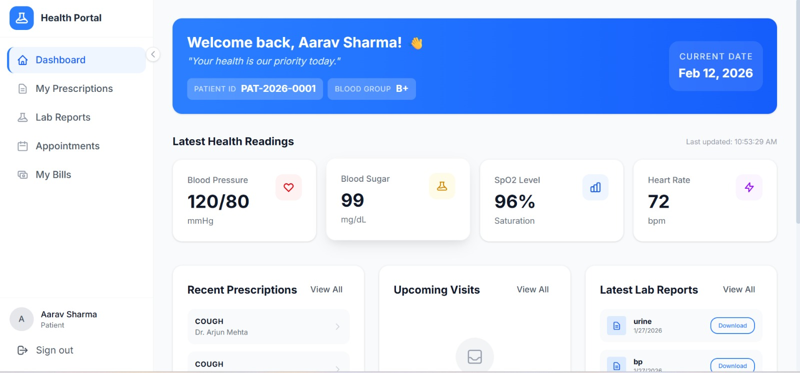
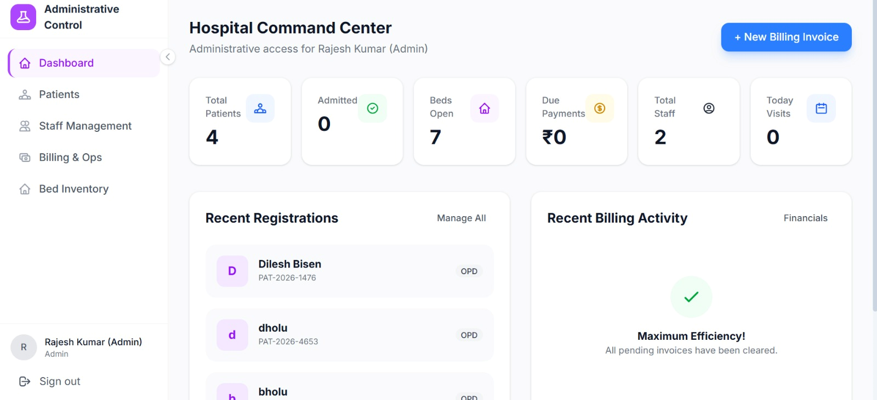
Implementation

Slide 16
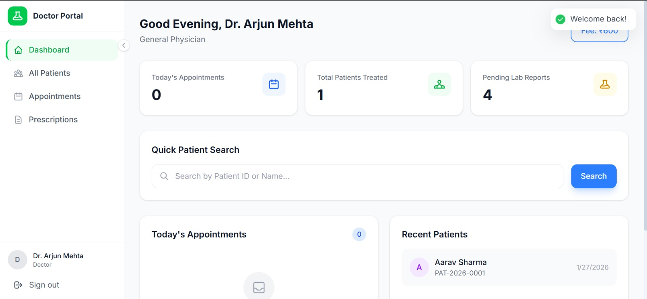
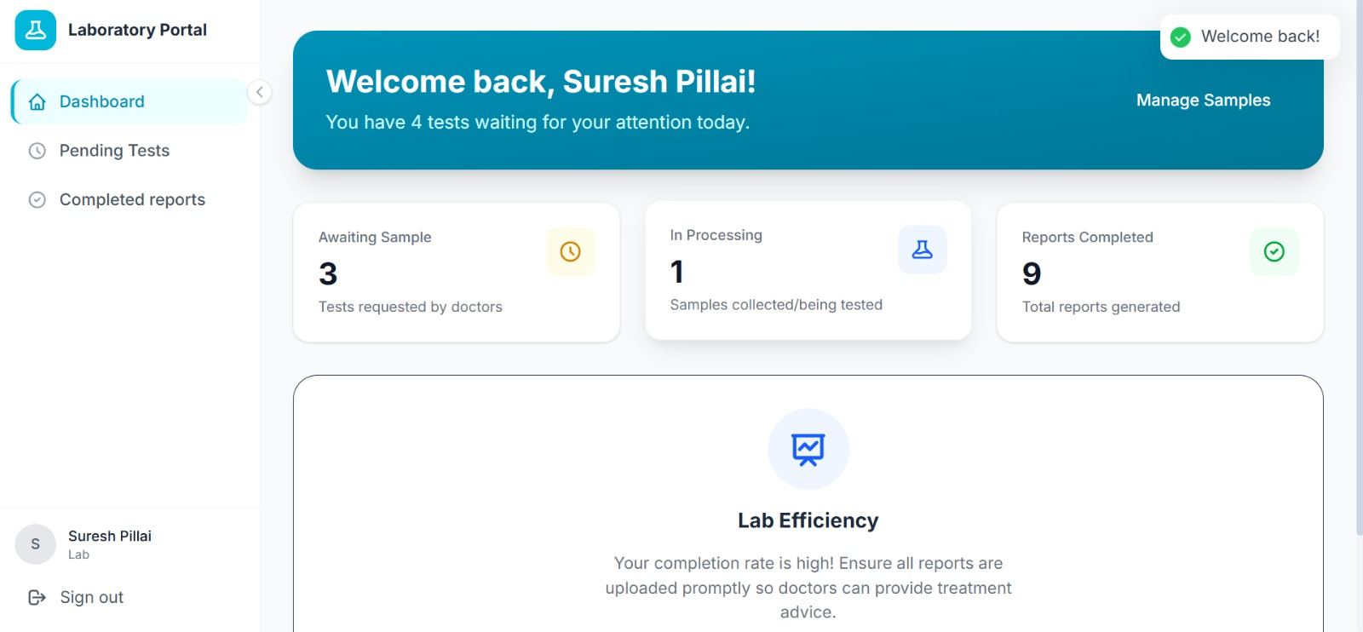

Slide 17
Results & Analysis
Operational Impact & Metrics :-
Real-Time Sync: Achieved instant data synchronization between Lab and Doctor modules, eliminating manual data entry delays.
Efficiency Gains: Transitioned from "Manual record handling" to a centralized system, significantly reducing paperwork and "Errors & Miscommunication".
Comparative Analysis :-
Feature | Existing Manual Systems | Proposed Digital HMS
Data Access | Fragmented & Slow | Centralized & Instant
Billing | Offline & Prone to Errors | Online & Collaborative
Security | Physical/Minimal Protection | JWT Auth + Database-level RLS
Patient Experience | Stressful & Delayed | Online Reports & Fast Service

Slide 18
Conclusion and Future work
Summary of Outcomes :-
Successfully developed a secure, cloud-based Hospital Management System that centralizes diverse medical workflows.
Transitioned hospital operations from manual, fragmented record handling to a streamlined digital environment.
Objectives Achieved :-
Role-Based Access: Implemented strict access control for Admin, Doctor, Lab, and Patient roles using Supa-base Auth and RLS.
Efficiency: Reduced administrative "Stress & Delays" and eliminated physical paperwork through automated workflows.
Scope of Improvement (Future Work) :-
Predictive Analytics: Integrating AI for early disease detection and preventive healthcare monitoring.
Enhanced Communication: Implementing automated SMS and email alerts for appointment reminders and report readiness.

Slide 19
References
[1] World Health Organization. "Global Health Observatory (GHO) data: Body mass index (BMI)." WHO. https://www.who.int/data/gho/data/themes/theme-details/GHO/body-mass-index (accessed Feb. 12, 2026).
[2] Meta Platforms, Inc. "Quick Start: Learning React." React Documentation. https://react.dev/learn (accessed Feb. 12, 2026).
[3] Supa-base. "Supa-base Documentation: Database, Auth, and Storage." Supa-base. https://supabase.com/docs (accessed Feb. 12, 2026).
[4] Supa-base. "Row Level Security (RLS) Guide." Supa-base. https://supabase.com/docs/guides/database/postgres/row-level-security (accessed Feb. 12, 2026).

Slide 20
Thank You...!!

